Slide 1
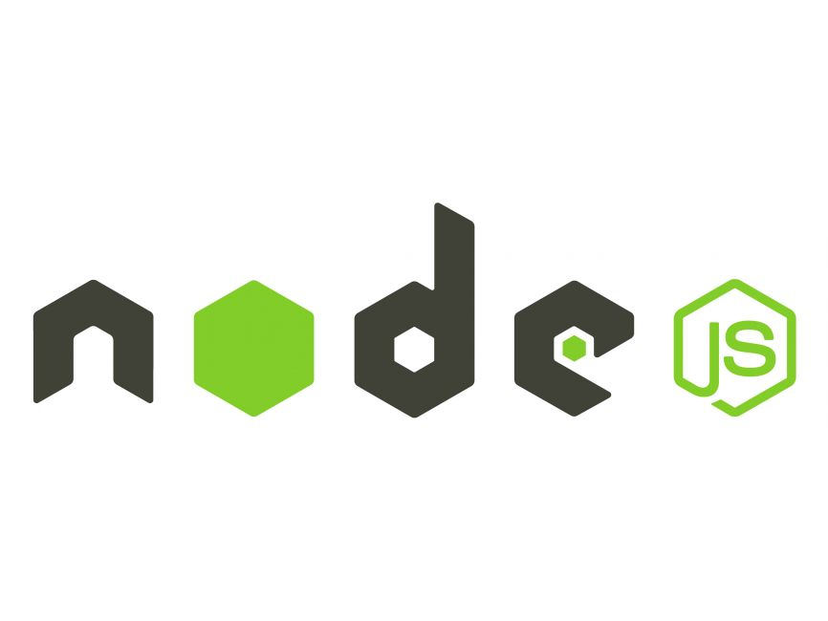
Node Js
What is Node.js used for?
What Node.js is good for?
Is Node.js free?
Is Node.js backend or frontend?
What is Module in Node.js?

Slide 2
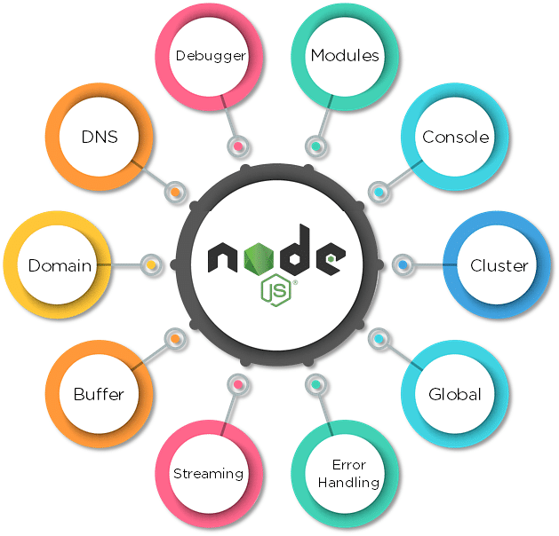
What is Node.js used for?
Node.js provides a runtime environment outside of the browser.
It's also built on the Chrome V8 JavaScript engine. This makes it possible to build back-end applications using the same JavaScript programming language you may be familiar with.

Slide 3
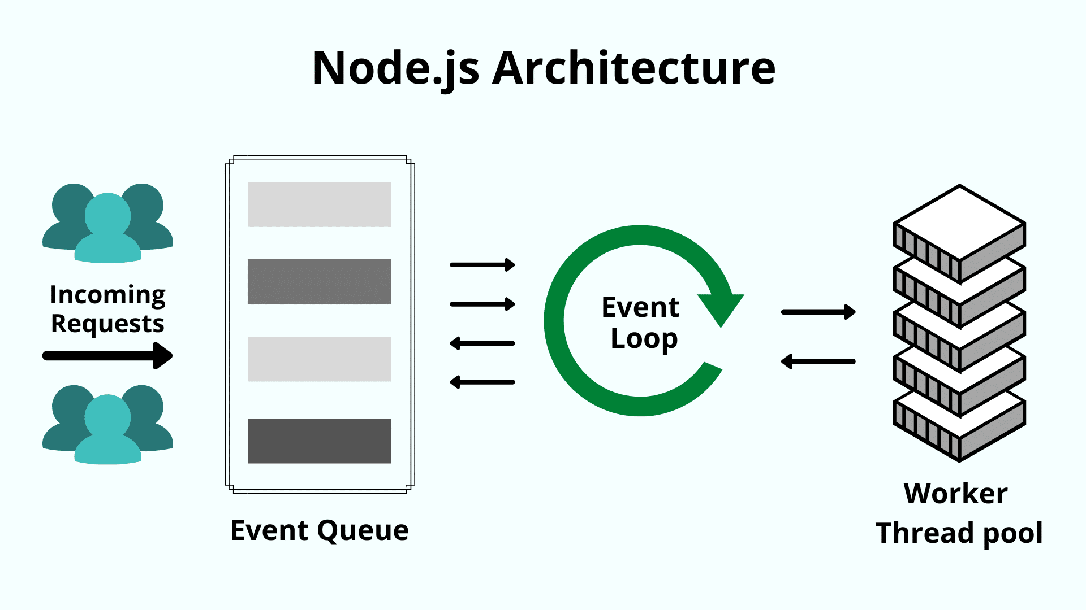

Slide 4
What Node.js is good for?
Node.js is the top choice for such enterprise companies as IBM, Microsoft, Uber, Trello and LinkedIn. It is suitable for development of real-time applications, IoT applications, and single-page applications.
Node js is used for building single-page applications and dynamic websites due to its ability to handle multiple requests asynchronously. It can serve dynamic content to users, improving the overall user experience.

Slide 5
Is Node.js free?
Node.js® is a free, open-source, cross-platform JavaScript runtime environment that lets developers create servers, web apps, command line tools and scripts.

Slide 6
Is Node.js backend or frontend?
Backend & Frontend
Node.js is sometimes misunderstood by developers as a backend framework that is exclusively used to construct servers. This is not the case; Node.js can be used on the frontend as well as the backend.
While Node.js is primarily known as a backend technology, it can also be used in the front-end development process. In fact, Node.js has gained popularity as a full-stack technology because of its versatility in handling both client-side and server-side tasks.

Slide 7
What is Module in Node.js?
A module in JavaScript is just a file containing related code. In JavaScript, we use the import and export keywords to share and receive functionalities respectively across different modules.
In Node.js, Modules are the blocks of encapsulated code that communicate with an external application on the basis of their related functionality. Modules can be a single file or a collection of multiple files/folders.

